Slide 1


PRESENTATION
ON
IoT Anomaly Detection System Using Unsupervised Machine Learning & Multi-Stage Data Pipeline
PREPARED BY :
Name: Md. Shaon Khalifa
ID : 251054
SUPERVISED BY :
Dr. Jesmin Akhter
Professor, IIT, JU
Date: 8th May 2026

Slide 2



MOTIVATION
Problem Statement & Motivation
The Industrial IoT Challenge
Industrial IoT environments generate massive, continuous streams of sensor data plagued by noise, missing values, and irregular patterns — making manual monitoring infeasible at scale.
Why Automated Anomaly Detection?
Undetected anomalies in sensor data lead to equipment failure, safety incidents, and costly downtime. Automated, intelligent detection is no longer optional — it is operationally critical.
The Research Gap
Existing supervised methods require labelled anomaly data, which is rarely available in industrial settings. This work addresses that gap using unsupervised machine learning on raw, unlabeled sensor streams.

Slide 3

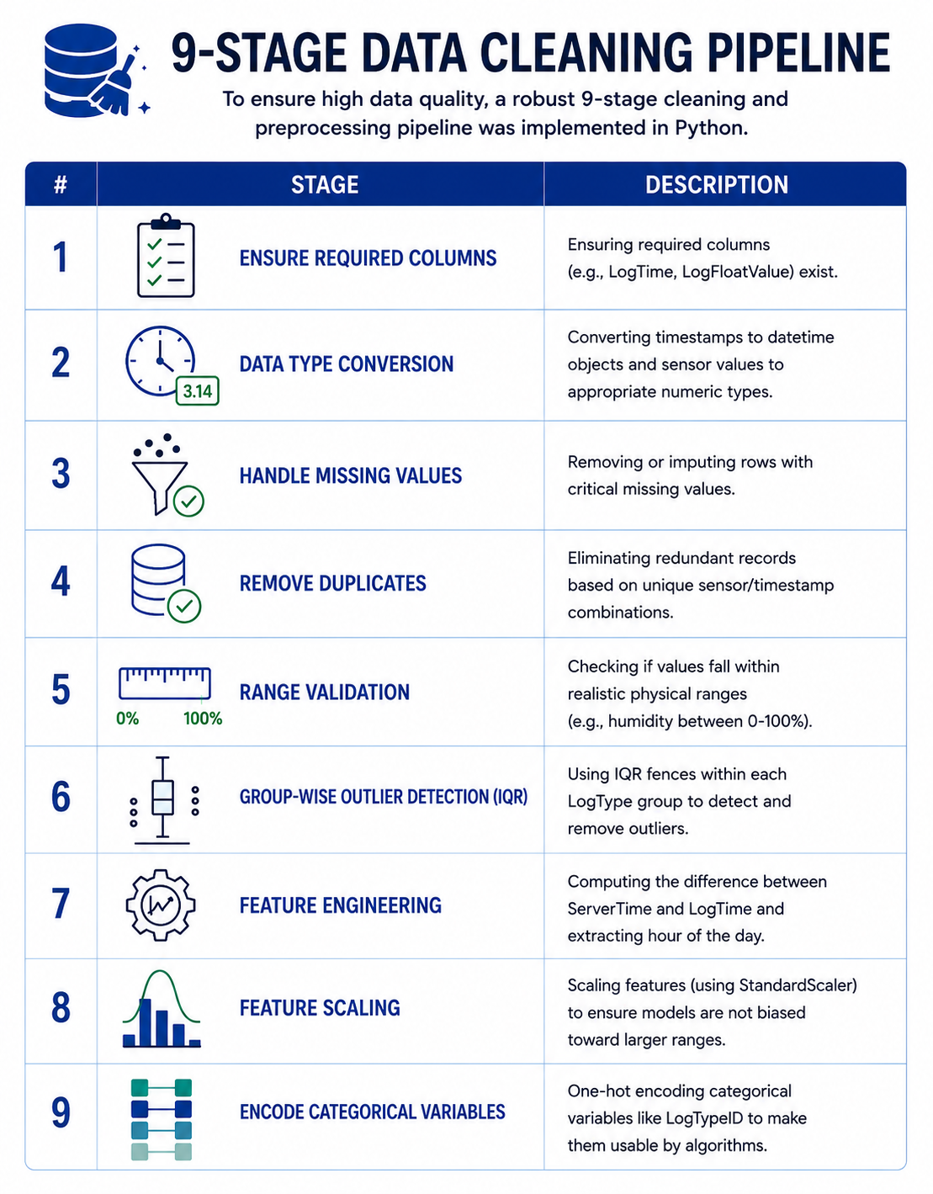

DATA PIPELINE
Multi-Stage Data Cleaning Pipeline
IQR Outlier Method
Interquartile Range filtering removes extreme spikes safely — robust for noisy sensor distributions.
Ingest
Validate
Impute
Annotate
Deduplicate
Each stage acts as a quality gate, ensuring only clean, reliable sensor readings reach the machine learning layer — dramatically improving model accuracy and robustness.
Diagnostic Metadata
Network delay and transmission timestamps are embedded as diagnostic features, enabling the system to distinguish genuine anomalies from communication artefacts.

Slide 4




ARCHITECTURE
3-Tier Microservices Architecture
Angular Frontend
.NET Backend
Python / Flask ML API
Interactive dashboard for real-time sensor data exploration, anomaly visualisation, and alert management
Core system routing, business logic, data orchestration, and secure communication layer between services
Separate microservice hosting the unsupervised models (Isolation Forest, K-Means, One-Class SVM).
Each tier is independently deployable and scalable, following microservices best practices. The separation of the ML service from core business logic ensures model updates can be rolled out without system downtime.

Slide 5
METHODOLOGY
Unsupervised Machine Learning Methodology
Isolation Forest
K-Means
One-Class SVM
Randomly partitions feature space; anomalies require fewer splits. Works well on high-variance industrial data.
Clusters normal behavior; points far from centroids are flagged as anomalies after distance thresholding.
Learns a boundary around normal data using kernel functions; points outside are anomalous but sensitive to scaling.
All three algorithms were trained exclusively on unlabelled sensor data, requiring no prior knowledge of what constitutes an anomaly — addressing the fundamental challenge of industrial IoT environments.

Slide 6
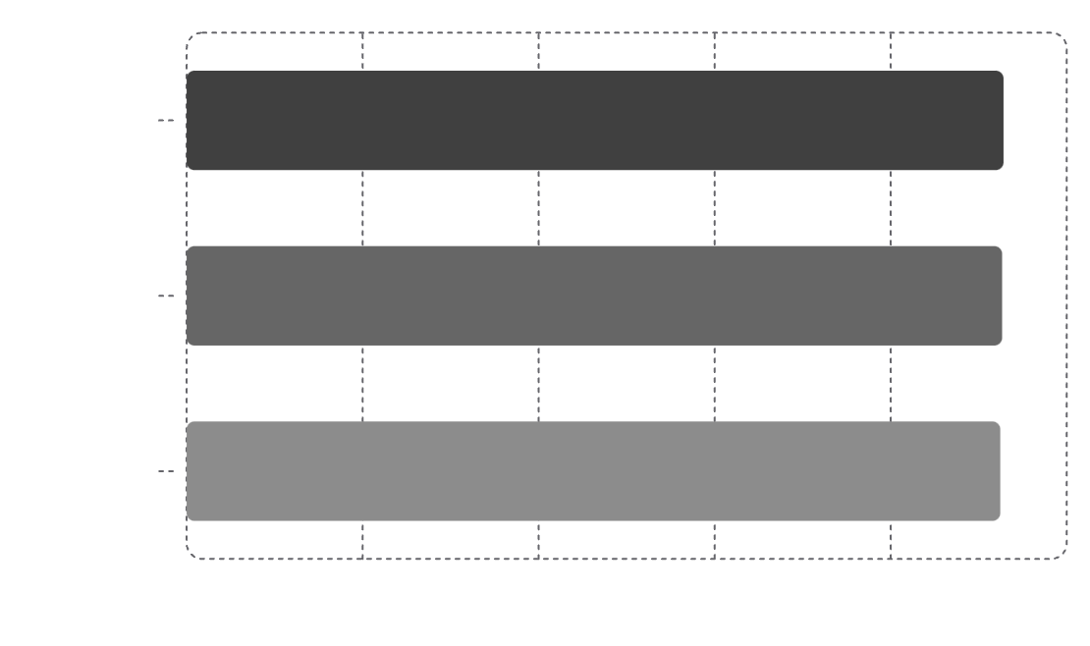
RESULTS
Model Evaluation & Results
92.81%
Isolation Forest
Highest accuracy — superior robustness in isolating anomalies within complex, high-variance industrial patterns
92.8
92.65%
92.7
K-Means
92.4
Strong performance on clearly separable cluster structures in normalised sensor data
92.44%
Isolation Forest leads due to its ability to efficiently isolate anomalies in complex, high-variance industrial data through random partitioning — without requiring a predefined cluster structure.
One-Class SVM
Competitive accuracy, though more sensitive to hyperparameter tuning and feature scaling

Slide 7

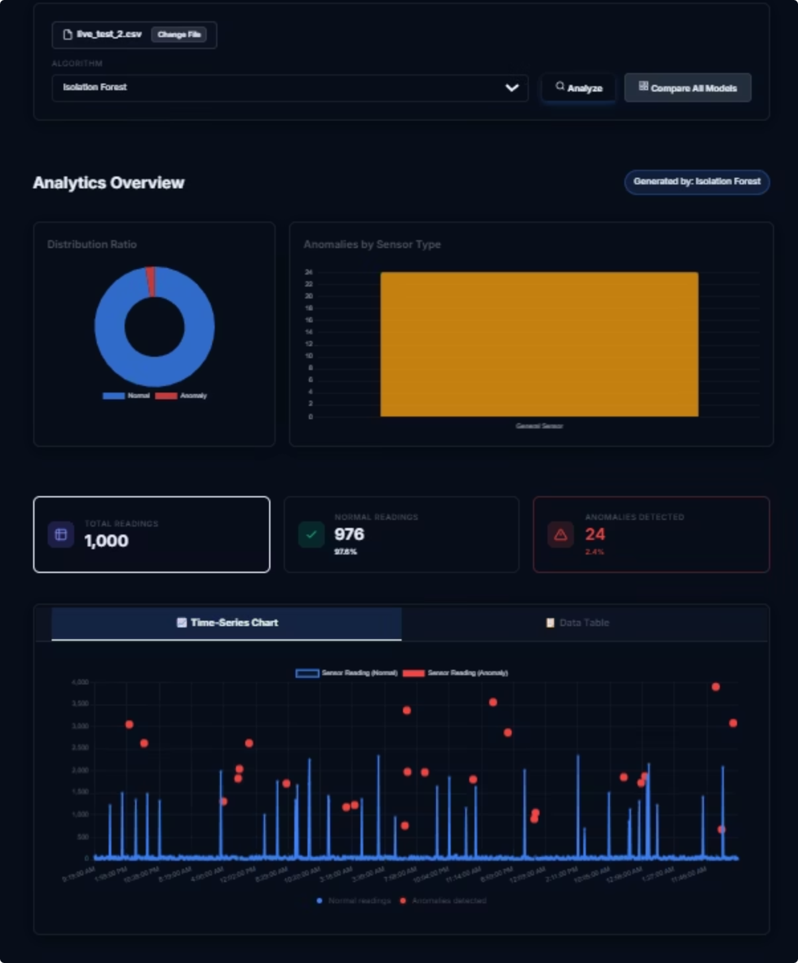
SYSTEM DEMO
Dashboard Capabilities
Real-Time Sensor Monitoring
Live visualisation of sensor streams with automatic anomaly flagging and colour-coded severity alerts rendered in the Angular frontend.
Interactive Data Exploration
Filtering by sensor type, time range, and anomaly category. Users can drill down into individual readings and inspect pipeline-stage diagnostics.
Model Selection & Comparison
The dashboard allows switching between Isolation Forest, K-Means, and One-Class SVM, displaying model-specific anomaly predictions side-by-side.
Pipeline Diagnostic View
Transparency layer exposing each of the 9 pipeline stages — including IQR filter activity and network delay metadata — for auditability and debugging.

Slide 8
LIMITATIONS & FUTURE WORK
Limitations & Future Directions
Current Limitations
Future Work
Complex Non-Linear Anomalies
Hybrid Ensemble Learning — combine Isolation Forest, K-Means, and One-Class SVM via voting or stacking to improve robustness across diverse anomaly types
Deep Learning Integration — explore LSTM autoencoders for temporal anomaly patterns in sequential sensor streams
Edge Deployment — optimise the pipeline and models for on-device inference at the IoT edge layer, reducing latency
Adaptive IQR — Implement sensor-specific, adaptive IQR thresholds that adjust to operational context
The current models struggle to reliably detect highly complex, non-linear anomaly patterns in extremely high-noise environments where decision boundaries are ambiguous.
Single-Model Dependency
Each model operates independently. In edge cases, no single algorithm consistently outperforms others across all sensor types and noise profiles.

Slide 9



CONCLUSION
Conclusion & Key Takeaways
Robust Pipeline
Scalable Architecture
Strong Results
Clean Data Wins
Scalable Build
Unsupervised Success
The 9-stage pipeline with IQR filtering produces high-quality inputs that significantly improve model reliability.
Angular + .NET + Flask architecture supports independent scaling and safe ML updates without downtime.
Isolation Forest achieved 92.81% accuracy, demonstrating unsupervised methods can be effective in industrial IoT.
Designed a production-grade anomaly detection system that cleans, enriches, and analyses industrial sensor data without labeled anomalies.

Slide 10
Thank You
Questions & Discussion

